Slide 1
Phaser 3
Phaser is an HTML5 game framework which aims to help developers make powerful, cross-browser HTML5 games. It was created specifically to harness the benefits of modern browsers, both desktop and mobile. The only browser requirement is the support of the canvas tag.

Slide 2
JavaScript for games
WebGL and canvas.
Other frameworks.
-BabylonJS
-MelonJS
-impactJS

Slide 3
Phaser 3 links
https://photonstorm.github.io/phaser3-docs/
https://phaser.io/
https://phaser.io/examples
https://phaser.io/tutorials/getting-started-phaser3
https://phaser.io/tutorials/making-your-first-phaser-3-game/part1

Slide 4
Additional things
https://rexrainbow.github.io/phaser3-rex-notes/docs/site/
-plugins, more examples
https://www.dofactory.com/javascript/design-patterns
-gang of 4 design patterns for JavaScript
https://opengameart.org/
-open-source game assets.

Slide 5
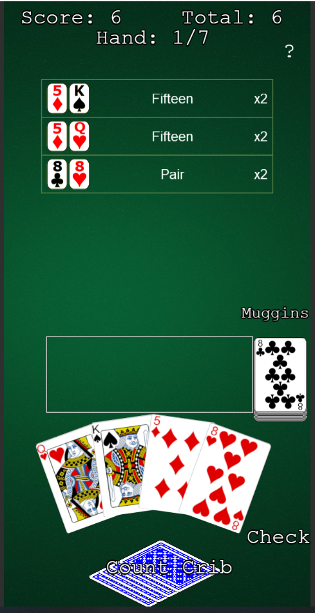
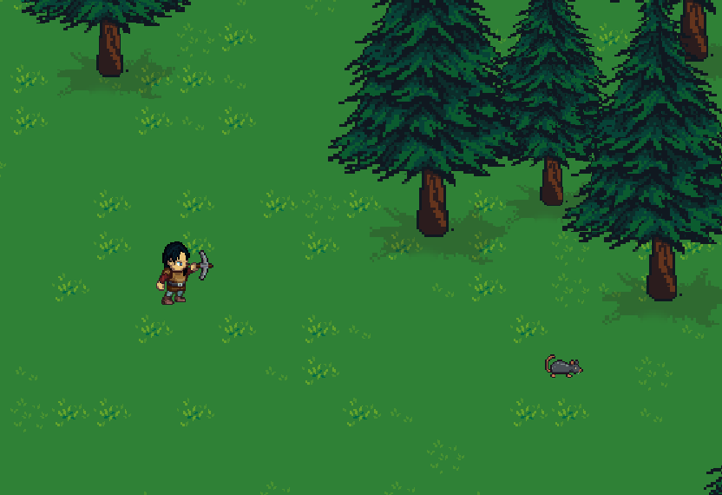
My works in progress
Cribbage, mobile or pc. Plans for mobile app with electron.
Browser based multiplayer RPG using socket messaging .

